Slide 1
Topic : Heart Disease Prediction using Machine Learning
PIP104 University Project-II
Review-2
CSE-G123
Batch Number:
Roll Number | Student Name
20201CSE0675 | LATTHIKA S
20201CSE0665 | KAKARLA MEHRUNNISA
20201CSE0685 | PALLAVI
Under the Supervision of,
Dr. Aarif Ahamed S
Assistant Professor
School of CSE&IS
Presidency University

Slide 2
Introduction
Cardiovascular Disease (CVD) & Global Impact: CVD accounts for nearly 31% of global deaths, highlighting its substantial impact on mortality worldwide.
Economic Burden of Heart Diseases: In India, heart-related ailments caused an economic loss of $237 billion between 2005 and 2015, signifying significant financial implications.
Importance of Heart Health: The heart plays a crucial role in supplying oxygen and nutrients throughout the body, with dysfunction posing substantial challenges to overall health.
Factors Contributing to Heart Diseases: Unhealthy lifestyles, including dietary patterns and modern rapid-paced living, significantly elevate the risk of heart diseases.
Machine Learning in Healthcare: The study explores machine learning's potential in analyzing patient data to predict heart diseases, focusing on risk assessment and symptom identification.
Model Evaluation & Performance: Initial deployment of various algorithms showcased diverse performances, with subsequent cross-validation and tuning significantly enhancing predictive capabilities.
Hybrid Model Achievement: The creation of a hybrid model combining Logistic Regression and CatBoost demonstrated exceptional predictive performance, achieving 97% accuracy and high precision and recall scores above 0.9

Slide 3
Literature Review
Author | YOP | Aim | Technologies Used | Drawbacks
Seyed Matin Malakouti [8] | 2023 | Heart disease classification based on ECG using machine learning models | machine learning algorithms, Dummy Classifier algorithm and cross-validation | Lack of Discussion on Model Limitations
Yagyanath Rimal, Siddhartha Paudel, Navneet Sharma, Abeer Alsadoon [11] | 2023 | Machine learning model matters its accuracy: a comparative study of ensemble learning and AutoML using heart disease prediction | Ensemble learning, Artificial neural network ,Support vector machine,K nearest neighbors, Random forest and AutoML | Achieved only 88% accuracy
Arman Naseri,David Tax, Pim van der Harst, Marcel Reinders, Ivo van der Bilt [9] | 2023 | Data-efficient machine learning methods in the ME-TIME study: Rationale and design of a longitudinal study to detect atrial fibrillation and heart failure from wearables | smartwatches for continuous monitoring of cardiovascular biomarkers, machine learning algorithms, and a cloud-based data platform | Challenge of labeling large amounts of continuous data, which is labor-intensive, and the need for machine learning methods that are data-efficient, i.e., needing a low number of labels

Slide 4
Literature Review
Author | YOP | Aim | Technologies Used | Drawbacks
Victor Chang, Vallabhanent Rupa Bhavani, Ariel Qianwen Xu, MA Hossain [4] | 2022 | An artificial intelligence model for heart disease detection using machine learning algorithms | Machine learning algorithms such as naive Bayes, random forest classification, logistic regression and decision trees. | Privacy concerns, Access control, Cost
Md Mamun Ali, Bikash Kumar Paul, Kawsar Ahmed, Francis M. Bui, Julian M. W. Quinn, Mohammad Ali Moni [2] | 2021 | Heart disease prediction using supervised machine learning algorithms: Performance analysis and comparison. | machine learning algorithms(k-nearest neighbor (KNN), decision tree (DT) and random forests (RF)) and data mining approaches6 | Dataset Source and Limitations, Ethical Considerations
Manoj Diwakar, Amrendra Tripathi, Kapil Joshi, Minakshi Memoria, Prabhishek Singh, Neeraj kumar [5] | 2020 | Latest trends on heart disease prediction using machine learning and image fusion | Machine learning algorithms(Naive bayes, Artificial neural network, K-nearest Neighbour Support vector machine,) and image fusion techniques | Limited Discussion of Results, Lack of Detailed Methodology

Slide 5
Literature Review
Author | YOP | Aim | Technologies Used | Drawbacks
Ivan Miguel Pires, Gonçalo Marques, Nuno M. Garcia and Vasco Ponciano [10] | 2020 | Machine learning for the evaluation of the presence of heart disease | artificial intelligence methods, including Neural Network, Decision Tree, k-Nearest Neighbour, Combined nomenclature rule inducer, Support Vector Machine, and Stochastic Gradient Descent | Dataset Characteristics and Limitations, Limited Comparative Analysis
Rahul Katarya and Sunit Kumar Meena [7] | 2020 | Machine Learning Techniques for Heart Disease Prediction: A Comparative Study and Analysis | Logistic Regression, K‑Nearest Neighbour, Support Vector Machine, Naïve Bayes, Decision Trees, Random Forest, Artificial Neural Network, | Evaluation Metrics, Algorithm Choice
Priya R. L, S Vinila Jinny, Yash Vijay Mate [6] | 2020 | Early prediction model for coronary heart disease using genetic algorithms, hyper‑parameter optimization and machine learning techniques | machine learning algorithms along with modern Gradient Boosting approaches, hyper parameter optimization techniques | An imbalanced dataset used

Slide 6
Literature Review
Author | YOP | Aim | Technologies Used | Drawbacks
Hager Ahmed,Eman M.G. Younis,Abdeltawab Hendawi,Abdelmgeid A. Ali [1] | 2019 | Heart Disease Identification from Patients’ Social Posts, Machine Learning Solution on Spark. | machine learning algorithms, hyperparameter tuning and cross-validation, feature selection algorithms, Apache Spark and Apache Kafka | Limited Generalizability, Lack of Comprehensive Comparison
Megha Bhushan, Akkshat Pandit, Ayush Garg [3] | 2019 | Machine learning and deep learning techniques for the analysis of heart disease: a systematic literature review, open challenges and future directions | Machine Learning and Deep Learning algorithms such as Convolutional Neural Networks (CNNs), recurrent neural networks, deep belief networks, long short-term memory. | dataset size (smaller for DL model), unavailability of some of the risk factors in the datasets and confidence intervals were wide

Slide 7
Drawbacks of Existing System
Biased Model Performance
Misclassification
Overfitting
Misleading Evaluation Metrics

Slide 8
PROPOSED METHODOLOGY
Creation of Hybrid Model:
A hybrid model using a voting classifier amalgamating Logistic Regression, CatBoost, and Random Forest strengths was crafted.
Hybrid Model Evaluation:
The Voting Classifier achieved impressive metrics:
97% accuracy
99% precision,
95% recall and
97% F1 score.

Slide 9
Objective
The primary objective of this project is to leverage machine learning techniques for the accurate prediction of heart disease.

Slide 10
Methodology
Data Collection and Preprocessing
Exploratory Data Analysis (EDA)
Feature Selection and Engineering
Model Selection
Model Evaluation
Cross-Validation and Hyper Parameter Tuning
Re- model Evaluation After Cross-Validation and Hyper parameter tuning
Comparative Analysis and Evaluation
Development of Hybrid Model

Slide 11
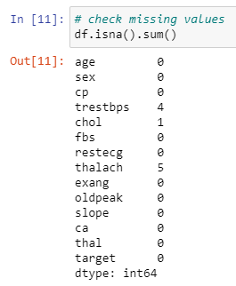
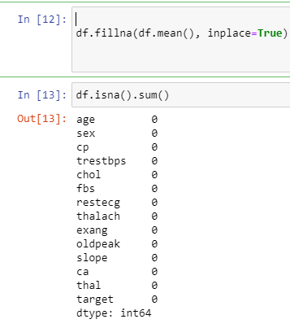
1. Data Collection and Preprocessing:
1.1Data Sourcing.
1.2 Data Cleaning
1.3 Data Split:
Handling Missing Values

Slide 12
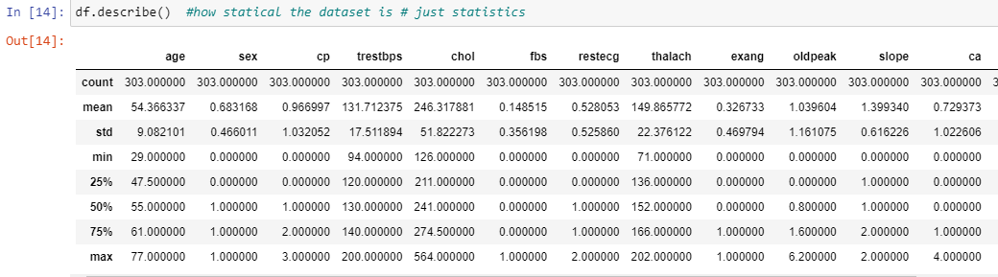
2.Exploratory Data Analysis (EDA):
2.1 Descriptive Analysis: Central Tendency, Dispersion, Correlation Analysis
2.2 Visualization: Histograms, Heatmaps, Scatter
Description Of The Data In The Dataframe

Slide 13
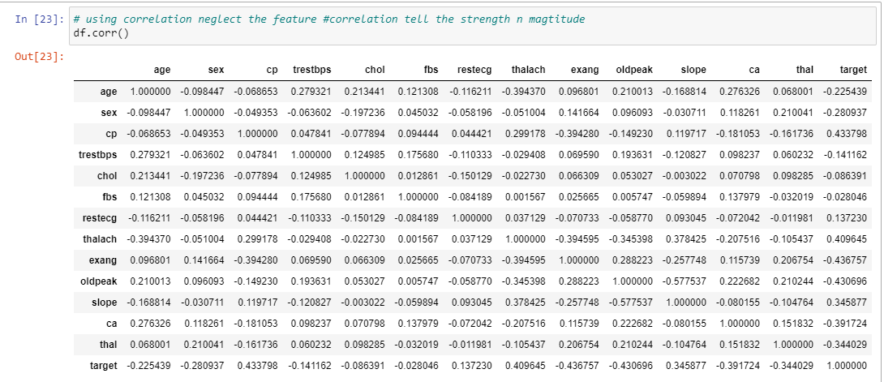
Correlation analysis

Slide 14
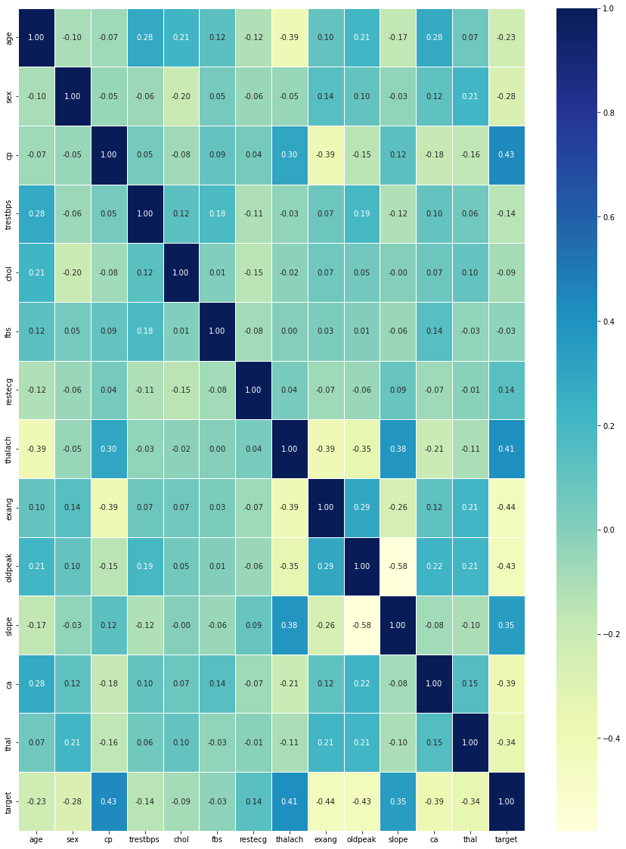
Correlation Matrix with Heat Map

Slide 15
3. Feature Selection and Engineering:
Feature Importance:
Employed techniques (e.g., statistical tests, correlation matrices) to select relevant features associated with heart disease.
Feature Engineering:
Created new features or transform from the existing ones to enhance the predictive power of the model.

Slide 16
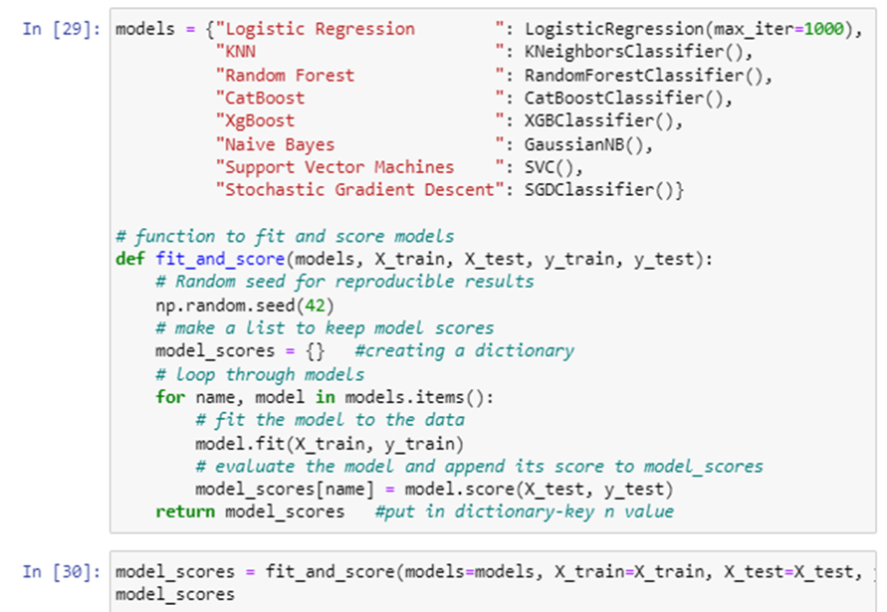
4. Model Selection
Implement a range of machine learning algorithms: Logistic Regression, K-Nearest Neighbors (KNN), RandomForest, CatBoost, XGBoost, Naive Bayes, Support Vector Machines (SVM), Stochastic Gradient Descent (SGD)
Model Implementation

Slide 17
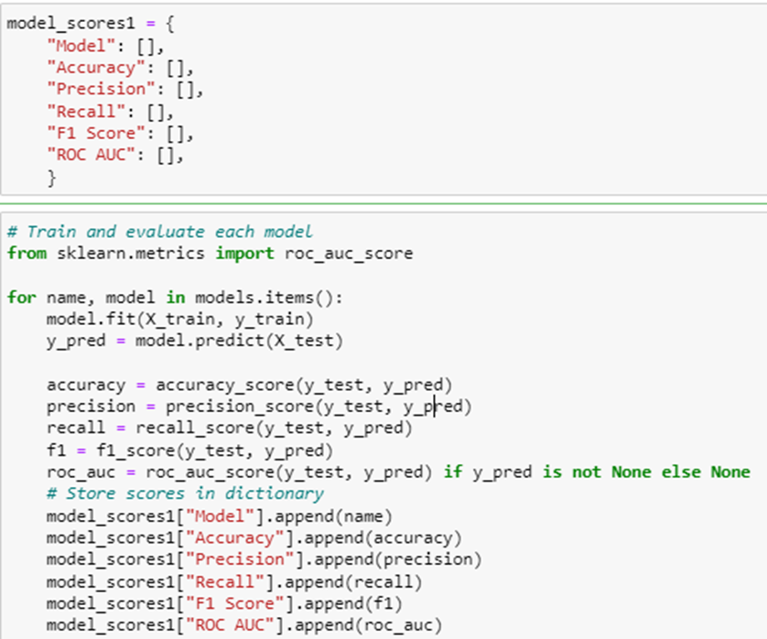
5.Model Evaluation
Evaluating the accuracy, precision, recall, f1 score and ROC AUC.
Model Evaluation

Slide 18
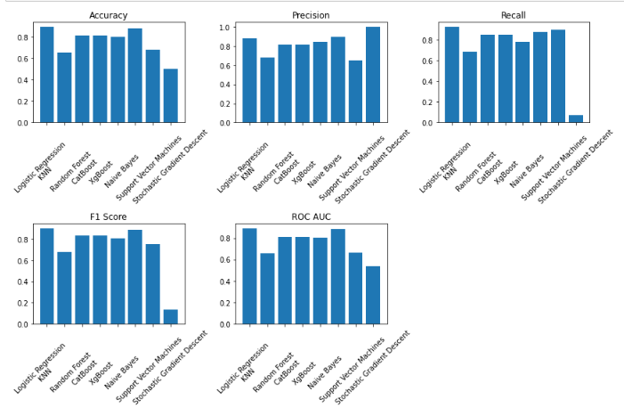
Model Evaluation Result

Slide 19
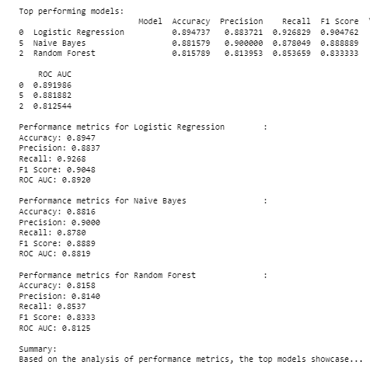
Model Evaluation Result

Slide 20
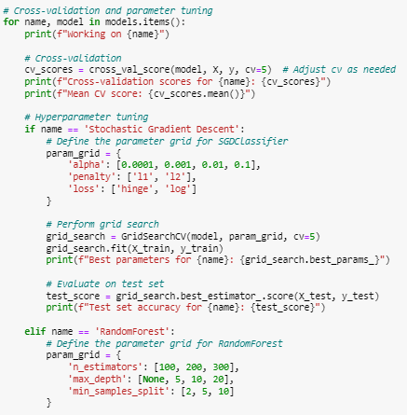
6.Cross Validation and Parameter Tuning :
Cross-validation involves partitioning the dataset into subsets to iteratively train and validate the model, ensuring robustness and preventing overfitting.
Hyperparameter tuning adjusts model parameters to optimize performance and enhance predictive accuracy..
Grid search exhaustively searches specified hyperparameter values to determine the optimal combination for model performance, while randomized search randomly selects hyperparameter values from specified ranges, reducing computational cost while finding effective parameters for model optimization.

Slide 21
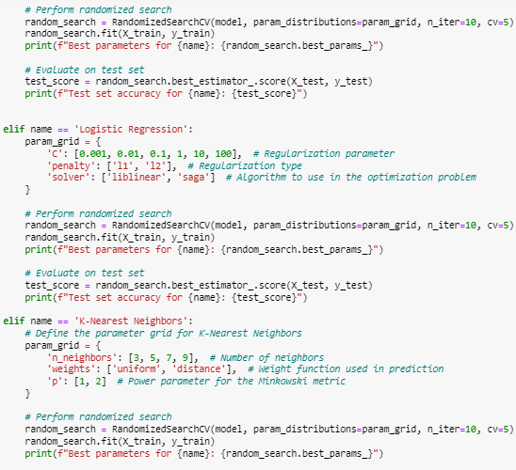
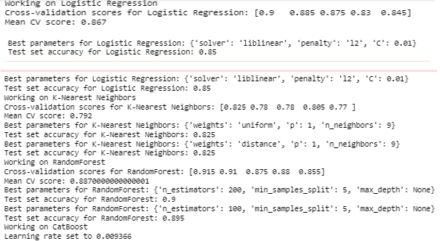
Hyper parameter tuning on Logistic Regression and K–Nearest Neighbors
Cross-Validation and Hyper parameter tuning Result

Slide 22
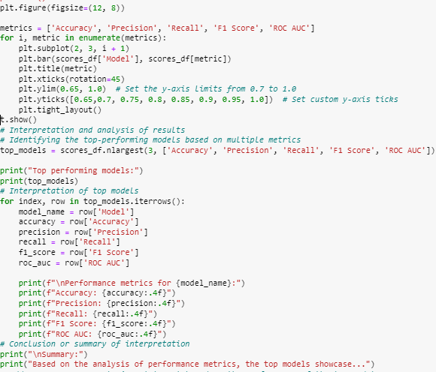
7. Re-model Evaluation after cross validation and Hyper parameter tuning:
Performance Evaluation on Test Set
Selecting the Best Model
Comparison with Initial Results
Providing Final Conclusions
Re- model Evaluation

Slide 23
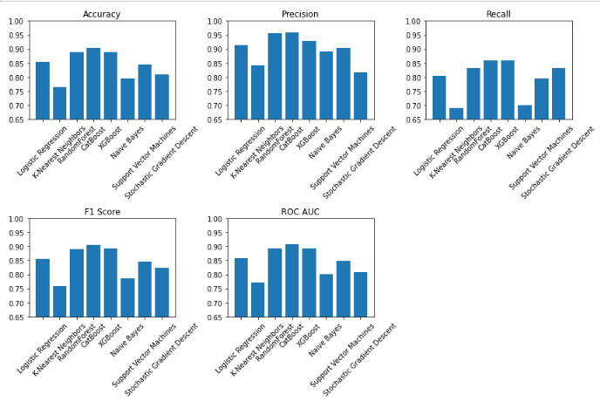
Re- model Evaluation Result

Slide 24
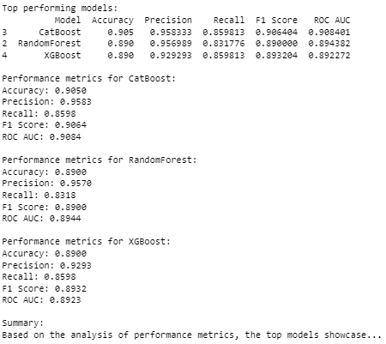
Re- model Evaluation Result

Slide 25
8.Comparitive Analysis and Evaluation
Before Tuning
Model | Accuracy | Precision | Recall | F1 Score | ROC AUC
Logistic Regression | 0.8947 | 0.8837 | 0.9268 | 0.9048 | 0.8920
Naïve Bayes | 0.8816 | 0.9000 | 0.8780 | 0.8889 | 0.8819
Random Forest | 0.8158 | 0.8140 | 0.8537 | 0.8333 | 0.8125

Slide 26
After Tuning (Cross-Validation & Hyperparameter Tuning
Model | Accuracy | Precision | Recall | F1 Score | ROC AUC
CatBoost | 0.9050 | 0.9583 | 0.8598 | 0.9064 | 0.9084
Random Forest | 0.8900 | 0.9474 | 0.8318 | 0.8900 | 0.8944
XGBoost | 0.8900 | 0.9293 | 0.8598 | 0.8932 | 0.8923

Slide 27
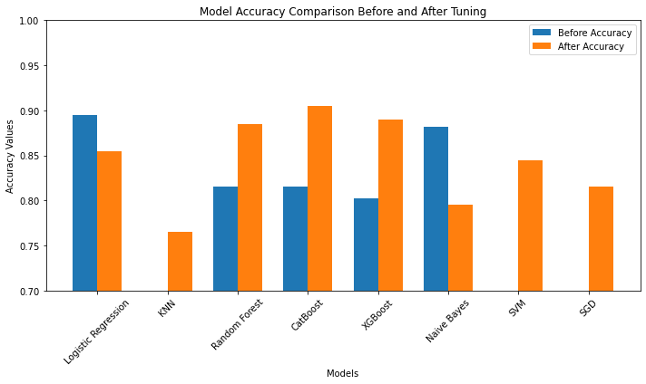
Comparative Analysis and Evaluation

Slide 28
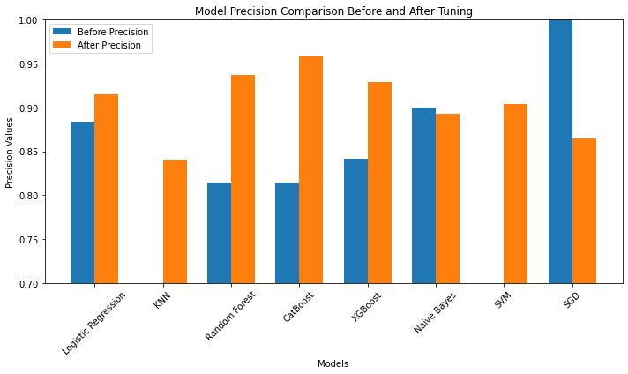
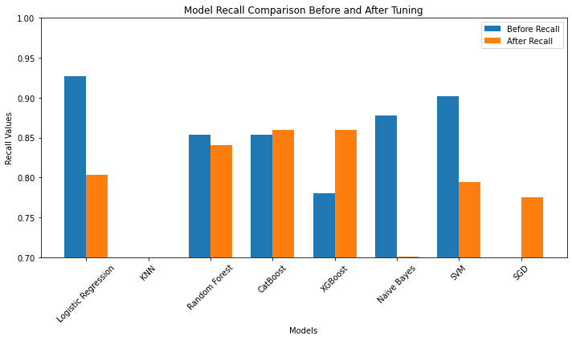

Slide 29
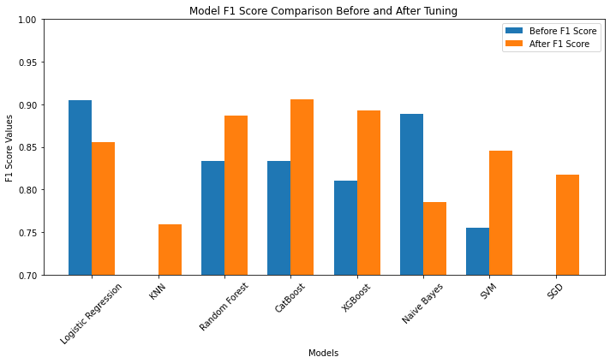


Slide 30
Best Model Selection
The evaluation highlights that CatBoost, after tuning, emerged as the most consistent and robust performer. It displayed noteworthy improvements in accuracy, precision, recall, F1 Score, and ROC AUC.
These enhancements position CatBoost as the top-performing model among the others, showcasing its suitability for this specific dataset and problem context.

Slide 31
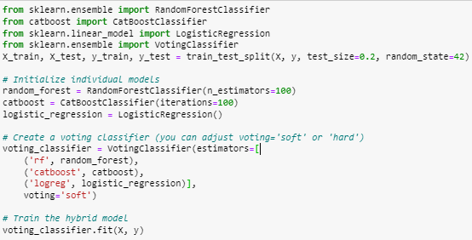
9.Development of Hybrid Model
Logistic regression deemed the best performer before cross-validation and hyperparameter tuning.
CatBoost, identified as the superior model after tuning
Random Forest, demonstrated consistent competence both before and after the tuning process.
Creation of a hybrid model using the VotingClassifier ensemble from Scikit-Learn.
Models are integrated into a VotingClassifier, which acts as a meta-estimator, combining the predictions of its constituent models.
The 'soft' voting scheme, employed in this instance.

Slide 32
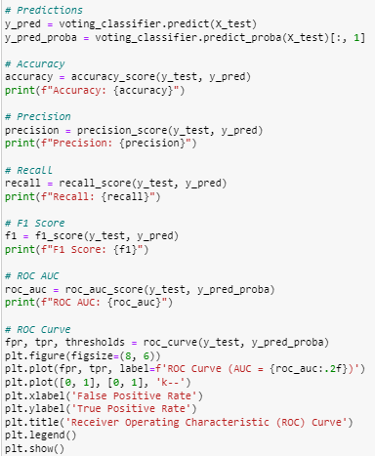
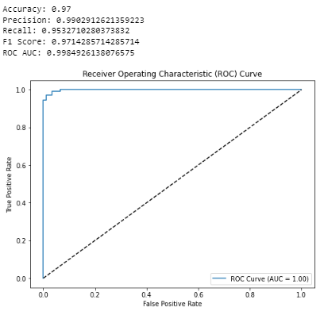
Evaluating the hybrid model
Hybrid model evaluation result

Slide 33
Timeline of Project

Slide 34
Expected Outcomes
Here are the potential outcomes:
Identification of Optimal Algorithms
Determine the most effective machine learning algorithms for heart disease prediction based on comprehensive comparative analysis and performance metrics. This outcome helps healthcare professionals select the most suitable models for accurate predictions.
Performance Metrics Insights
Provide detailed insights into the performance metrics (accuracy, precision, recall, etc.) of each algorithm. Highlight their strengths and weaknesses, aiding in informed decision-making regarding algorithm selection in clinical settings.
Model Interpretability
Offer insights into the interpretability of models, understanding how each algorithm makes predictions. This outcome aids in trust-building among healthcare practitioners who might need to comprehend and trust the model's decisions.

Slide 35
Conclusion
This project aimed to analyze extensive medical data, employing various machine learning algorithms to predict heart diseases efficiently.
Initial utilization of Logistic Regression, Naive Bayes, and Random Forest showcased top models based on multiple metrics.
Following cross-validation and tuning, CatBoost, RandomForest, and XGBoost emerged as superior performers, enhancing accuracy, precision, and F1 scores.
The culmination was a hybrid model utilizing a Voting Classifier, combining Logistic Regression ,CatBoost and Random Forest achieving a remarkable 97% accuracy with enhanced precision, recall, F1 score, and ROC AUC.

Slide 36
References
Ahmed, H., Younis, E. M., Hendawi, A., & Ali, A. A. (2020). Heart disease identification from patients’ social posts, machine learning solution on Spark. Future Generation Computer Systems, 111, 714-722
Ali, M. M., Paul, B. K., Ahmed, K., Bui, F. M., Quinn, J. M., & Moni, M. A. (2021). Heart disease prediction using supervised machine learning algorithms: Performance analysis and comparison. Computers in Biology and Medicine, 136, 104672
Bhushan, M., Pandit, A., & Garg, A. (2023). Machine learning and deep learning techniques for the analysis of heart disease: a systematic literature review, open challenges and future directions. Artificial Intelligence Review, 1-52
Chang, V., Bhavani, V. R., Xu, A. Q., & Hossain, M. A. (2022). An artificial intelligence model for heart disease detection using machine learning algorithms. Healthcare Analytics, 2, 100016
Diwakar, M., Tripathi, A., Joshi, K., Memoria, M., & Singh, P. (2021). Latest trends on heart disease prediction using machine learning and image fusion. Materials Today: Proceedings, 37, 3213-3218
Jinny, S. V., & Mate, Y. V. (2021). Early prediction model for coronary heart disease using genetic algorithms, hyper-parameter optimization and machine learning techniques. Health and Technology, 11, 63-73
Katarya, R., & Meena, S. K. (2021). Machine learning techniques for heart disease prediction: a comparative study and analysis. Health and Technology, 11, 87-9
Malakouti, S. M. (2023). Heart disease classification based on ECG using machine learning models. Biomedical Signal Processing and Control, 84, 104796.
Naseri, A., Tax, D., van der Harst, P., Reinders, M., & van der Bilt, I. (2023). Data-efficient machine learning methods in the ME-TIME study: Rationale and design of a longitudinal study to detect atrial fibrillation and heart failure from wearables. Cardiovascular Digital Health Journal
Pires, I. M., Marques, G., Garcia, N. M., & Ponciano, V. (2020). Machine learning for the evaluation of the presence of heart disease. Procedia Computer Science, 177, 432-437.
Rimal, Y., Paudel, S., Sharma, N., & Alsadoon, A. (2023). Machine learning model matters its accuracy: a comparative study of ensemble learning and AutoML using heart disease prediction. Multimedia Tools and Applications, 1-18

Slide 37
Thank You

